Slide 1
Syllogisms
Deductive Reasoning
Categorical syllogisms

Slide 2
A deductive argument is an argument in which it is thought that the premises provide a guarantee of the truth of the conclusion.
In a deductive argument, the premises are intended to provide support for the conclusion that is so strong that, if the premises are true, it would be impossible for the conclusion to be false.

Slide 3
An argument is a connected series of statements or propositions, some of which are intended to provide support, justification or evidence for the truth of another statement or proposition.
Arguments consist of one or more premises and a conclusion. The premises are those statements that are taken to provide the support or evidence; the conclusion is that which the premises allegedly support.

Slide 4
For example, the following is an argument:
The death penalty should be adopted only if it deters murder. However, it could only do this if murderers understood the consequences of their actions before acting, and since this is not so, we must reject adopting the death penalty.
The conclusion of this argument is the final statement: “we must reject adopting the death penalty.” The other statements are the premises; they are offered as reasons or justification for this claim. The premises of an argument are sometimes also called the “data,” the “grounds” or the “backup” given for accepting the conclusion.
http://www.iep.utm.edu/ded-ind/

Slide 5
Aristotle
In ancient Greece, the philosopher Aristotle challenged his students with logic problems call syllogisms. A syllogism has three parts, and must be worded in a particular way.
All dogs are barking animals.
All poodles are dogs.
Therefore, all poodles are barking animals.

Slide 6
The first line gives you one piece of information—all dogs are barking animals.
The second line gives you another piece of information—all poodles are dogs.
Each of the first two statements in a syllogism is called a premise.
The information is put together to get the conclusion.
The conclusion is the third statement in a syllogism.
If the conclusion is supported by the information in the premises, it is valid.

Slide 7
Valid or Invalid?
All poodles are dogs.
All poodles are barking animals.
Therefore, all dogs are barking animals.
First premise
Second premise
But when you put the information from the two premises together, you don’t have enough information to conclude anything about all dogs.
Invalid

Slide 8
The three statements in this type of logic problem are called an argument. It has a conclusion that must be supported by two premises.
There are three different categories, or sets, in a syllogism. In the syllogism about dogs, the three sets are dogs, barking animals, and poodles.
It is a rule that each statement in a syllogism must contain two of the three sets.
It also is a rule that each set must be used only twice.

Slide 9
Sets in Syllogisms
What are the sets in this syllogism?
All flowers are pretty:_______and______
All daffodils are flowers:_______and_____
Therefore, all daffodils are pretty:_____&____
Is this a valid syllogism?

Slide 10
Sets in Syllogisms
What are the sets in this syllogism?
All flowers are pretty: flowers and pretty
All daffodils are flowers: daffodils and flowers
Therefore, all daffodils are pretty: daffodils and pretty
Is this a valid syllogism? Valid

Slide 11
Another Syllogism
All flowers are pretty.
All daffodils are pretty.
Therefore, all daffodils are flowers.
Is it valid?

Slide 12
Another Syllogism
All flowers are pretty.
All daffodils are pretty.
Therefore, all daffodils are flowers.
Is it valid? No
The two premises give no
Information about all daffodils
Being flowers or flowers being
Daffodils.

Slide 13
Valid or Invalid?
All dogs have three legs.
All ducks are dogs.
Therefore, all ducks have three legs.
All dragons are green.
All green things are ugly.
There all dragons are ugly.

Slide 14
Valid or Invalid?
All dogs have three legs.
All ducks are dogs.
Therefore, all ducks have three legs.
Valid
All dragons are green.
All green things are ugly.
There all dragons are ugly.
Valid

Slide 15
Definition: A categorical syllogism is a simple, basic syllogism consisting of three parts: two premises and one conclusion, all of which are categorical propositions. Also characteristic of a categorical syllogism is that it has just three categorical terms (quantifiers, for example: some, all, no, etc.), each of which can be used in only two of the parts.

Slide 16
A syllogism is a type of formal logical argument. Syllogisms come in three sentences, each with a subject and predicate:
Major Premise: Subject, predicate Minor Premise: Subject, predicate Conclusion: Subject, predicate

Slide 17
The major premise is the first premise in a syllogism and contains both major term and the middle term. The major term is the predicate term of the conclusion and the middle term is the term that occurs in both premises, but not in the conclusion.
The minor premise is the second premise in a syllogism and contains both the minor term and the middle term. The minor term is the subject term of the conclusion.

Slide 18
Each part thereof is a categorical proposition, and each categorical position containing two categorical terms.^{[2]}
In Aristotle, each of the premises is in the form "Some/all A belong to B," or "Some/all A is/are [not]B," where "A" is one term and "B" is another, but more modern logicians allow some variation.
Each of the premises has one term in common with the conclusion: in a major premise, this is the major term (i.e., the predicate of the conclusion); in a minor premise, it is the minor term (the subject) of the conclusion.

Slide 19
Major premise: All men are mortal.
Minor premise: Socrates is a man.
Conclusion: Socrates is mortal.
Each of the three distinct terms represents a category, in this example, "men," "mortal," and "Socrates." "Mortal" is the major term; "Socrates", the minor term. The premises also have one term in common with each other, which is known as the middle term in this example, "man."

Slide 20
Major premise: All mortals die.
Minor premise: All men are mortals.
Conclusion: All men die.
Here, the major term is "die", the minor term is "men," and the middle term is "mortals". Both of the premises are universal.

Slide 21
All animals are mortal.
All men are animals.
All men are mortal.
No reptiles have fur.
All snakes are reptiles.
No snakes have fur.
No homework is fun.
Some reading is homework.
Some reading is not fun

Slide 22
The formal fallacy of illicit major is committed in categorical syllogisms when the major term appears in the conclusion, but not in the major premise.
All men are mortal No women are men Therefore, no women are mortal.

Slide 23
The predicate terms in the conclusions are "animals" and "women," and the conclusion refers to all members of those classes. (In the group made up of all animals, we will not find any birds.) However, in the premises where these terms appear (the major premise), only some members are referred to. (Some animals are cats.) An argument is invalid when the conclusion is about every member of the major term but the major premise must does not refer to every member of the major term.
All P are Q No X are P No X are Q

Slide 24
The formal fallacy of illicit minor is committed in categorical syllogisms when the minor term appears in the conclusion, but not in the minor premise.
All cats are animals. All cats are pets. Therefore, all animals are pets.

Slide 25
One way to understand how the above is a fallacy is to notice that the syllogism does not state "All P and only P..." If the argument read "All cats and only cats..." in both premises, then the conclusion would follow. An argument is invalid if the conclusion is about every member of the minor term but the minor premise does not also refer to every member of the minor term.
All P are Q All P are X Therefore, all Q are X

Slide 26
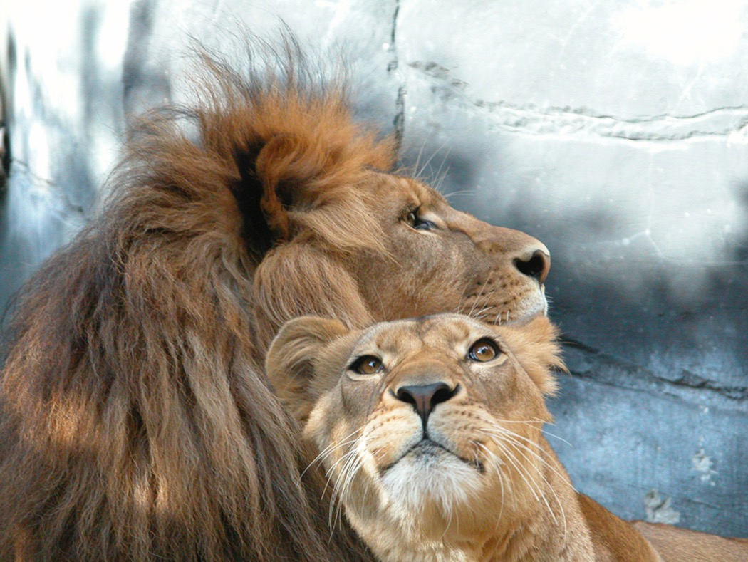
All cats are mammals This animal is a cat Therefore, this cat is a mammal.

Slide 27
All humans are mortal, the major premise, I am a human, the minor premise, therefore, I am mortal

Slide 28
Major premise: All asteroids are made of rock. Minor premise: Ceres is an asteroid. Conclusion: Ceres is made of rock.
Major premise: No cat enjoys the company of snakes. Minor premise: Fluffy enjoys the company of snakes. Conclusion: Fluffy is not a cat.
Major premise: I will not eat anything that smells like feet. Minor premise: Some kinds of cheese smell like feet. Conclusion: There are some kinds of cheese I will not eat

Slide 29
Add the Conclusion
All children are TV watchers.
No TV watchers are pigs.
Therefore,
All carrots are vegetables.
All vegetables are nutritious.
Therefore,

Slide 30
Add the Conclusion
All children are TV watchers.
No TV watchers are pigs.
Therefore, No children are pigs or No pigs are children.
All carrots are vegetables.
All vegetables are nutritious.
Therefore, All carrots are nutritious.

Slide 31
More. . .
No human beings are fish.
All trout are fish.
Therefore,
Some good students are female.
All good students are hard workers.
Therefore,

Slide 32
More. . .
No human beings are fish.
All trout are fish.
Therefore, No human beings are trout or no trout are human beings.
Some good students are female.
All good students are hard workers.
Therefore Some females are hard workers or some hard workers are females.

Slide 33
All fragile things are breakable things. Some glasses are fragile things. Therefore All mammals are warm-blooded animals. All whales are mammals. Therefore All books are things with pages. Some books are mysteries. Therefore

Slide 34
All flowers are pretty objects. All pansies are flowers. Therefore No animals are plants. All sheep are animals. Therefore

Slide 35
Possible Answers
therefore glasses are breakable whales are warm blooded mysteries have pages pansies are pretty objects sheep are not plants

Slide 36
Complete syllogism handout and Write two original syllogisms.

Slide 37
Deductive Reasoning

Slide 38
Deductive reasoning is one of the two basic forms of valid reasoning.
While inductive reasoning argues from the particular to the general, deductive reasoning argues from the general to a specific instance.
The basic idea is that if something is true of a class of things in general, this truth applies to all legitimate members of that class.
The key, then, is to be able to properly identify members of the class.
Miscategorizing will result in invalid conclusions.

Slide 39
Deductive reasoning works from the more general to the more specific.
Sometimes this is informally called a "top-down" approach.
We might begin with thinking up a theory about our topic of interest.
We then narrow that down into more specific hypotheses that we can test.
We narrow down even further when we collect observations to address the hypotheses.
This ultimately leads us to be able to test the hypotheses with specific data -- a confirmation (or not) of our original theories.

Slide 40
Gravity makes things fall. The apple that hit my head was due to gravity.
There is a law against smoking. Stop it now.

Slide 41
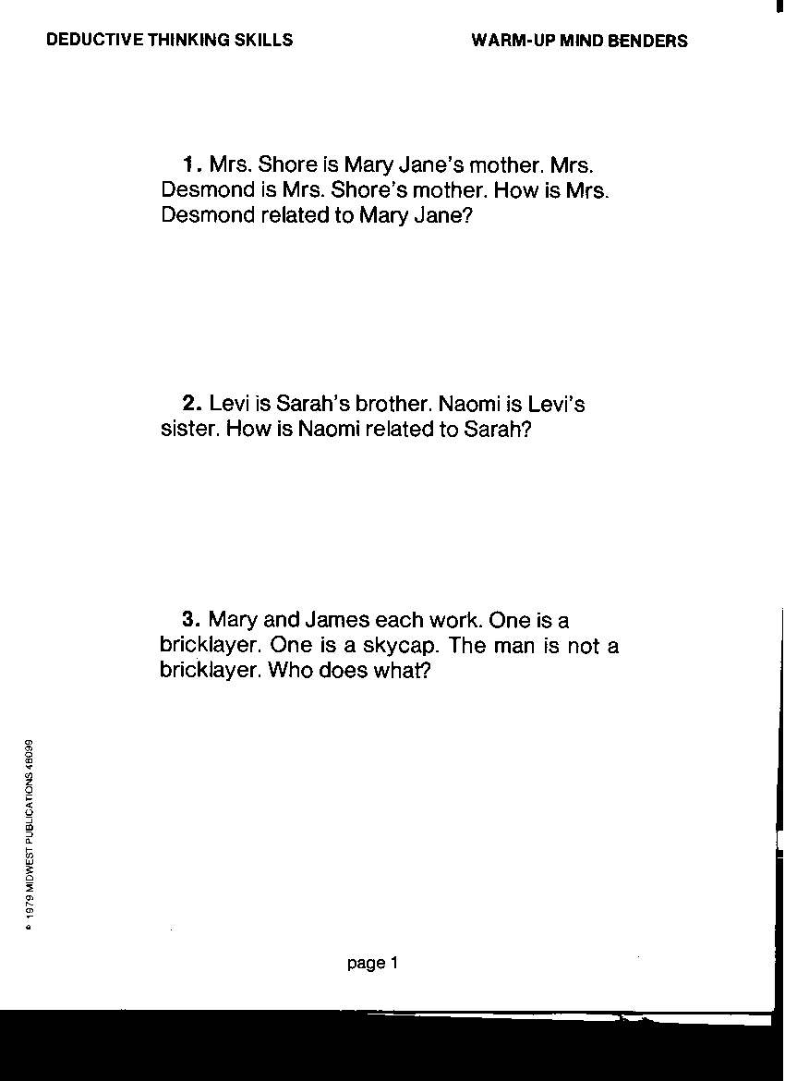

Slide 42
She is Mary Jane’s grandmother
She is Sarah’s sister
Mary is a bricklayer

Slide 43
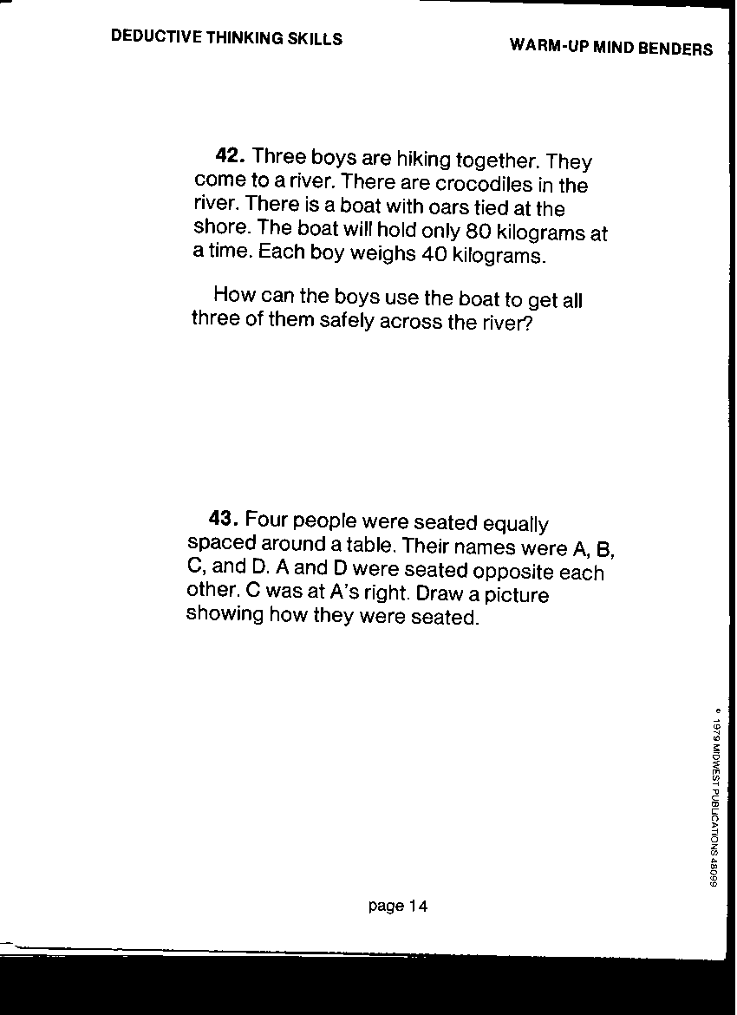

Slide 44
Two of the boys row over, leaving the third one behind. On the other side, one boy gets
Out of the boat, and the other one rows back. He picks up the boy who was left behind.
They row over to the other side.
A
C
B
D

Slide 45
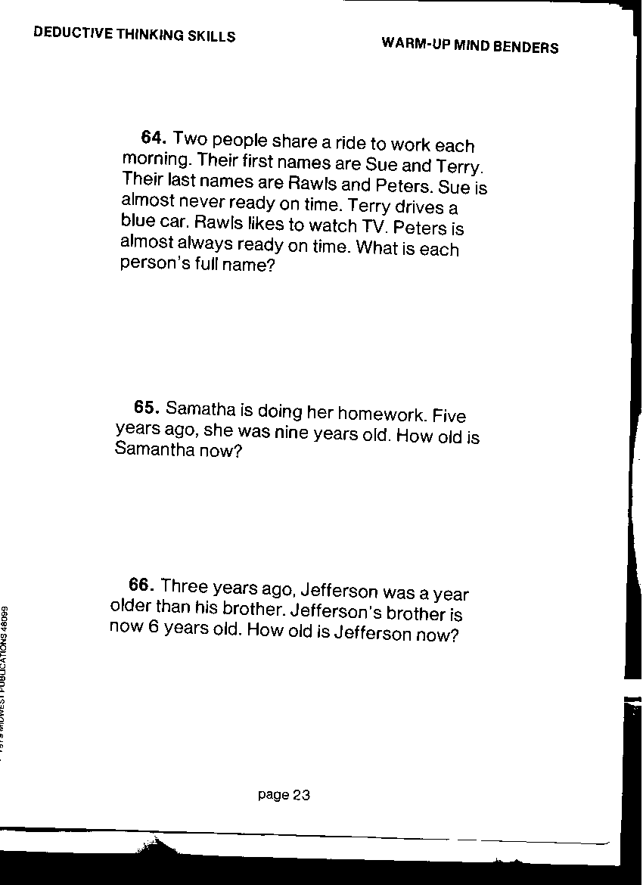

Slide 46
Sue Rawls and Terry Peters
14 years old
7 years old

Slide 47
Two fathers and two sons have a total of $30 between them. Each man has $10. Explain.
A total of $30 and each man having $10 suggests a total of three individuals. Father/son status isn't as certain, as one man may be both at once. A son/grandson, father/son and father/grandfather solves the apparent dilemma quite nicely.

Slide 48
Matrix Logic
To do matrix logic problems, start by gathering information from clues. These clues can be tricky. One clue may give you only a little information by itself, but may give more information when you fit it together with another clue.

Slide 49
Candy, Candy, Candy
Tina hates chocolate bars.
Kathy eats taffy.
Jake hates lollipops.

Slide 50
Candy, Candy, Candy
To record the information in this problem, record on a chart called a matrix. Write down the children’s names in the boxes on the side, and the three kinds of candy in the boxes on the top.
 | Choc. Bars | Taffy | Lollipops
Tina | X
Kathy
Jake

Slide 51
Candy, Candy, Candy
Write Yes where Kathy and taffy meet. The mark X in the other two boxes next to Kathy’s name. Finally, mark X where Tina and taffy meet and where Jake and taffy meet.
 | Choc. Bars | Taffy | Lollipops
Tina | X
Kathy | X | Yes | X
Jake |  | X

Slide 52
Candy, Candy, Candy
Mark X in the box where Jake and lollipops meet. Now you can see that there’s only one space left next to Tina’s name—lollipops. Mark that Yes. And there’s only one space left next to Jake’s name– chocolate bars. Mark that box Yes.
 | Choc. Bars | Taffy | Lollipops
Tina | X | X | Yes
Kathy | X | Yes | X
Jake | Yes | X | X

Slide 53
Candy, Candy, Candy
The matrix logic problem is solved.
 | Choc. Bars | Taffy | Lollipops
Tina | X | X | Yes
Kathy | X | yes | X
Jake | Yes | X | X

Slide 54
Flowers
Karen, Derek, Fay, Tanya, and Scott each have a special favorite flower. No two of them have the same favorite. Which person matches which flower?
Karen’s favorite is not the tulip.
Derek hates tulips and roses.
Someone really likes daisies.
Fay likes violets.
Tanya is allergic to carnations.
Scott likes the flower to which Tanya is allergic

Slide 55
Flowers
Karen, Derek, Fay, Tina, and Scott each have a special favorite flower. No two of them have the same favorite. Which person matches which flower?
Karen’s favorite is not the tulip.
Derek hates tulips and roses.
Someone really likes daisies.
Fay likes violets.
Tina is allergic to carnations.
Scott likes the flower to which Tanya is allergic
 | Roses | carnations | violets | tulips | daisies
Karen | Yes | X | X | x | X
Derek | X | X | X | X | Yes
Fay | X | x | Yes | X | X
Tina | X | X | X | Yes | X

Slide 56
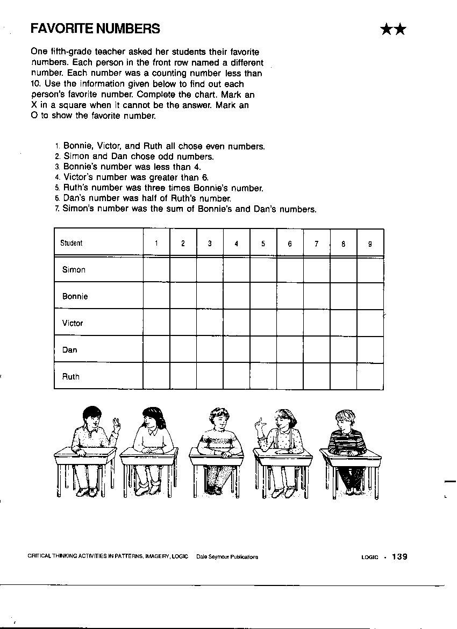

Slide 57
X X X X O X X X X
X X X X X X X X
X X X X X X X X
X X X X X X X X
X X X X X X X X

Slide 58
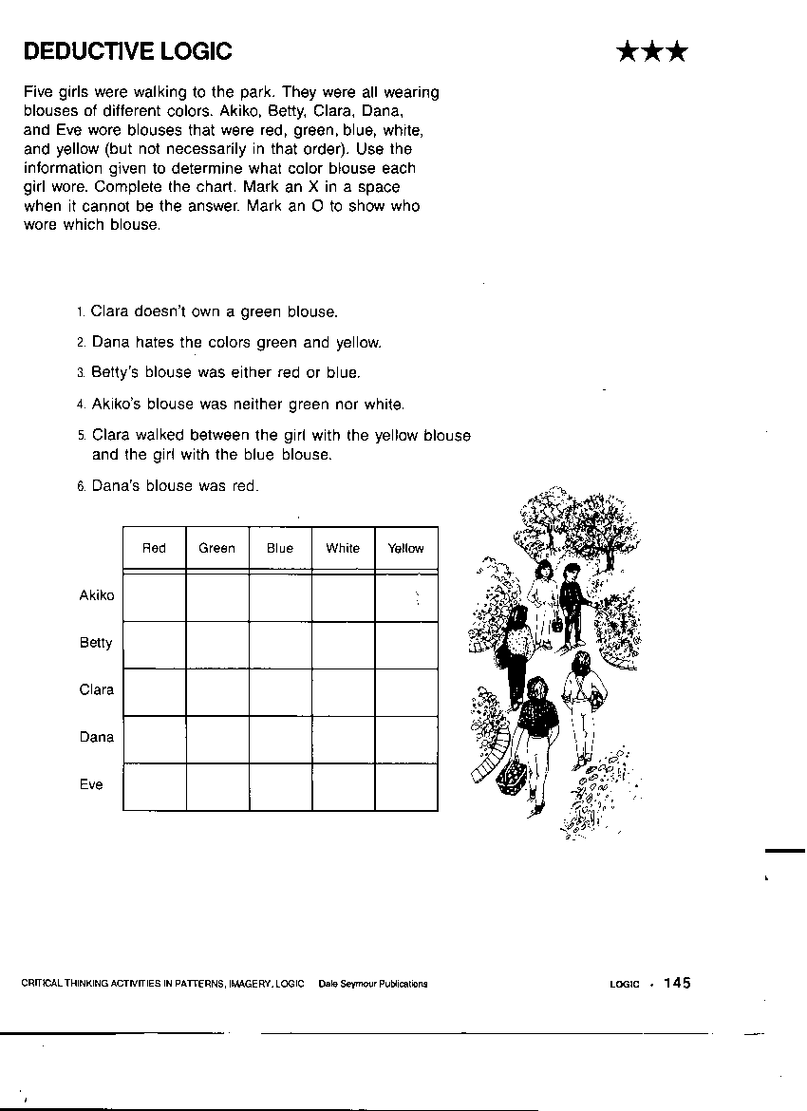

Slide 59
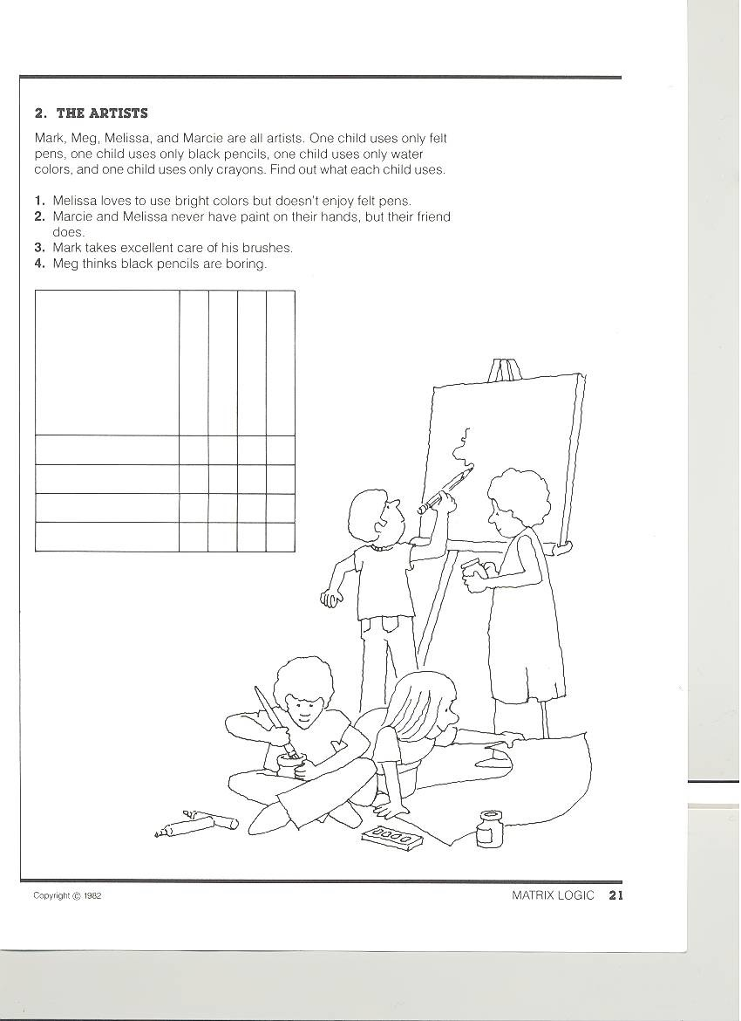
Create an original matrix logic problem using the following information. This
Assignment is due Thursday.

Slide 60
Create an original matrix logic problem using the following information. This
Assignment is due Thursday.
Create an original Matrix Logic problem.
Use the names Pat, James, and Lori
Use the foods pizza, fish and hotdogs.

Slide 61
That’s All!

